Slide 1
Esports Data Analysis: Valorant
By George Vo

Slide 2
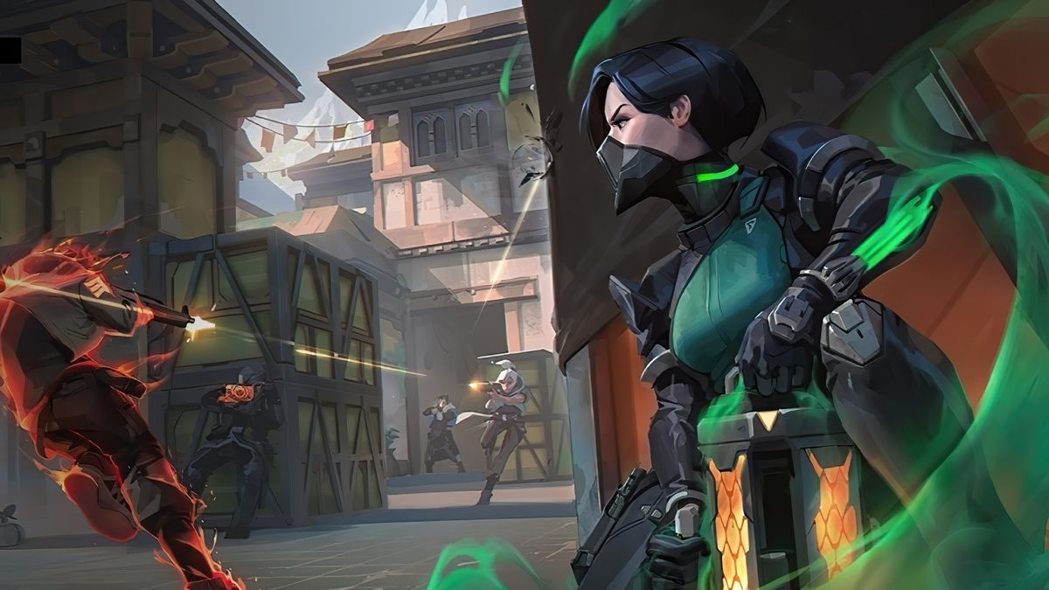
Introduction: What is Valorant?
Tactical first-person shooter (FPS)
5 Attackers vs 5 Defenders
Attackers must plant a bomb in the defenders’ territory, while defenders must prevent the bomb plant or defuse the bomb
Agents
Unique abilities and roles
Ex: grenades, smokes, healing
Economy
In-game system
Buy weapons, shields, abilities, etc.

Slide 3
Objective: Predict Wins
Based on the player’s past performance data, can we predict if they will win a Valorant pro match?
Match outcomes
Player stats: kills, deaths, assists, etc.
Agent compositions
Advanced statistics*
Stakeholders
Players
Coaches
Analysts
Esports betters
Spectators
Notes:
If audience is unfamiliar with valorant, compare to basketball

Slide 4
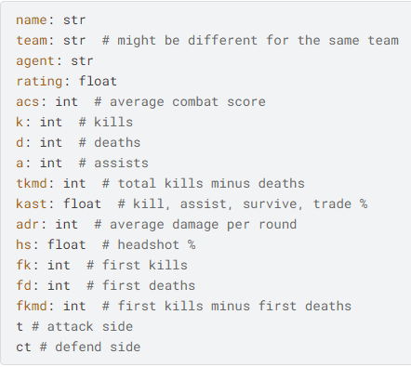

Data Collection
Dataset
Scraped from vlr.gg
~250k samples
Each data point is a player’s performance data per match

Slide 5
Data Preprocessing
Corrupt data
Interesting outlier:
ACS > 1,000 for a whole side during 13-0 scoreline
13 occurrences in ~250k samples
Type casting
Define win
Winning team score > Losing team score
13-11, 13-0, 15-13 are the same win
Encode categorical variables
Map
Player name
Agent
Standardizing data values

Slide 6
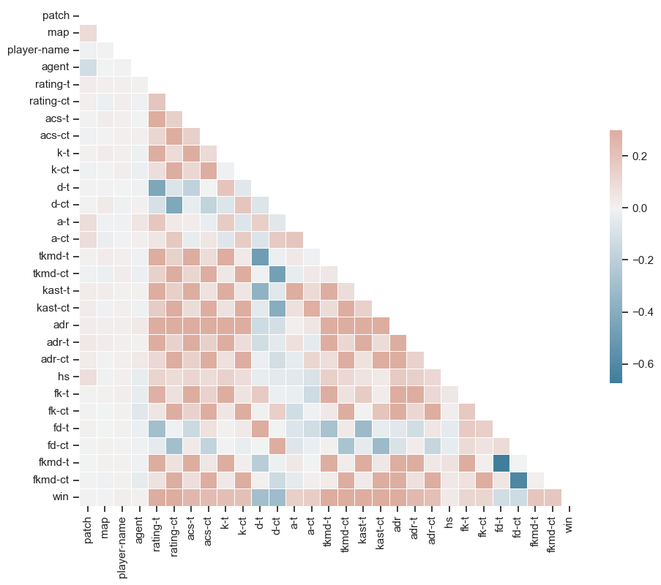
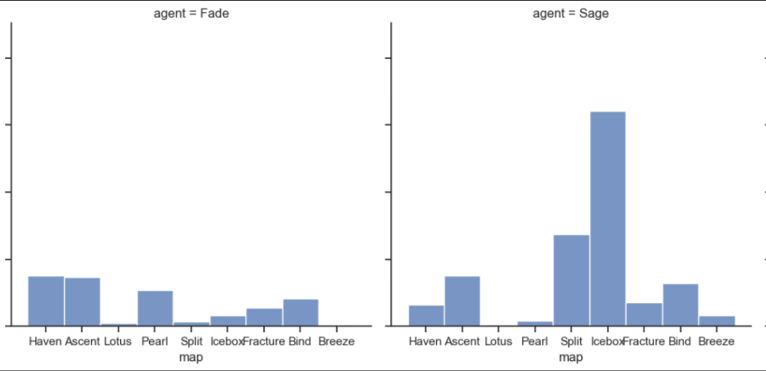
Exploratory Data Analysis

Slide 7

Feature Engineering
Drop overall stats to focus on side-based stats
Advanced player statistics
KAST%
Rating
28 features
Correlation between rating, ACS, kills
Notes:
“The core idea behind this algorithm is that not all kills are created equal. Every fight is assigned a weight based on the situation in the round (how many people on each team are alive, if the kill was traded, the economic situation etc). That weight is added to the killer's kill contribution and subtracted from the victim's death contribution. Getting a kill in a 5v1 is weighted less than getting a kill in a 5v5.”

Slide 8
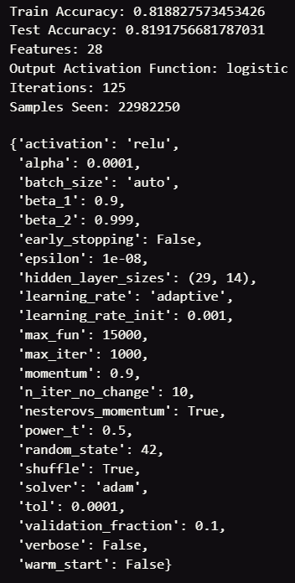
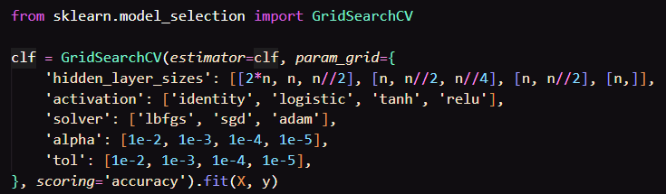
Model: Multilayer Perceptron Classifier
Pros
Versatile
Complex linear relationships
Large datasets
Cons
Overfitting
Tuning
Expensive
Large datasets
Blackbox

Slide 9
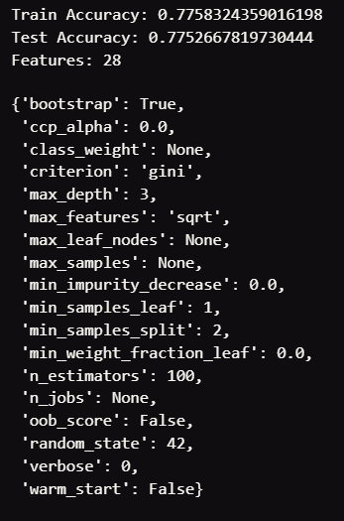
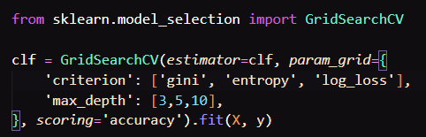
Model: Random Forest
Pros
Less overfitting
Feature importance
Cons
Interpretability
Expensive
Memory intensive

Slide 10
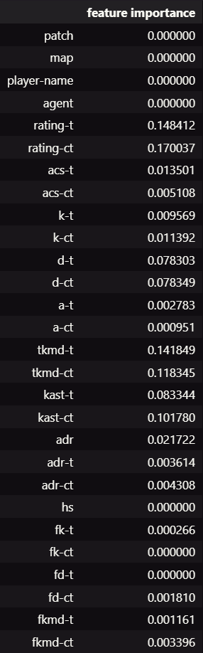
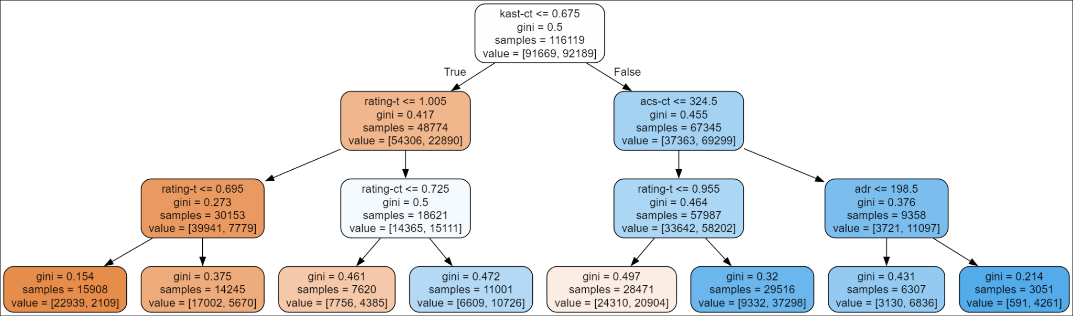
Random Forest Cont.
random tree in forest

Slide 11
Improvements
Data
Kill distance
Utility usage
Distance to cover
Number of combatants involved in a fight, or distance to teammates (on both sides)
Holistic approach
Combinations of specific players
Teamwide stats
Past performance against specific players
Predict score differential
Edge cases
Purposefully dying for economy boost

Slide 12
Impact
Advanced statistics, such as KAST% and Rating
Some factors are difficult to quantify!
Teamplay
Strategies
Protocols
Counterstrategies
In-Game Leader (IGL)
Future questions
Which statistics are the most important for specific agent roles?
Which professional team will win the next world championship?
What are each team/players’ statistical strengths and weaknesses?

